Slide 1
Data – The Fabric Of Our Lives
SQL Saturday Baton Rouge – July 29, 2023

Slide 2

He / him pronouns
Microsoft Data Platform MVP
MCSE: Data Management and Analytics
Albuquerque data platform group leader
Contact me:
Twitter: @ChrisHyde325
Email: chrishyde325@gmail.com
Chris Hyde
Owner and Principal Consultant
Hydrate Consulting, LLC
@ChrisHyde325

Slide 3


Please scan the QR code on the room schedule to fill out your session evaluation.

Slide 4


















SQL Saturday Baton Rouge 2023
Thank you, Sponsors!

Slide 5
Agenda
“100 level” overview of Microsoft Fabric
Not a deep dive!
OneLake and lakehouse architecture
Discuss the different components of Fabric
Demos for some components intermingled

Slide 6
What is Microsoft Fabric?
Microsoft’s next generation all-in-one data analytics product
Full integration of data warehousing, data engineering, and data science tools into the same portal as Power BI (reporting and data visualization)
Software-as-a-Service (SaaS) rather than Platform-as-a-Service (PaaS)
One copy of data in the integrated OneLake data lake

Slide 7
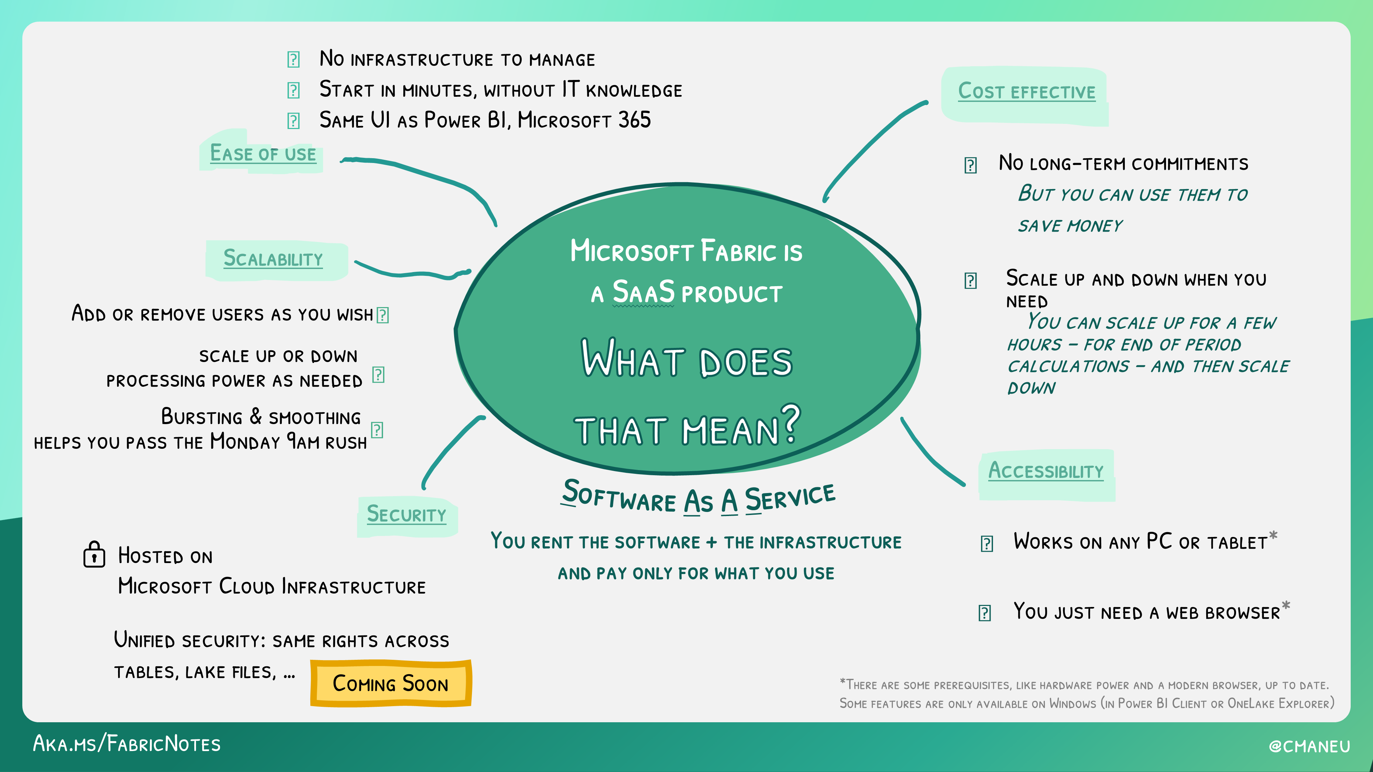

Slide 8
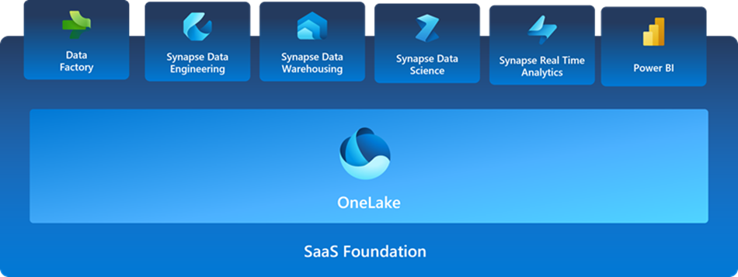
SaaS Foundation

Slide 9
OneLake
“OneDrive for data”
Full compatibility with Azure Data Lake Storage Gen2
Shortcut feature allows data virtualization across other ADLSg2, Amazon S3, and (soon) Google Storage
Data stored in the open-source Delta Parquet format

Slide 10
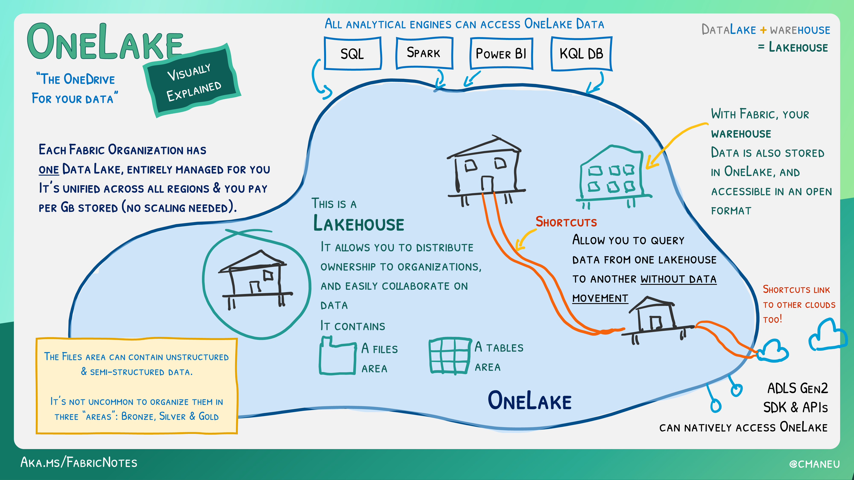

Slide 11
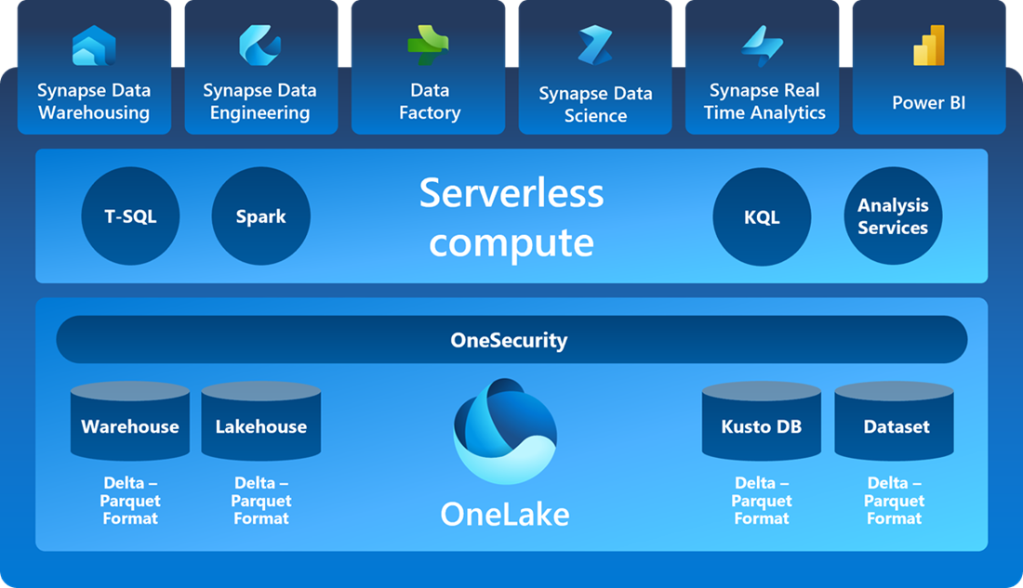
SaaS Foundation, part 2

Slide 12
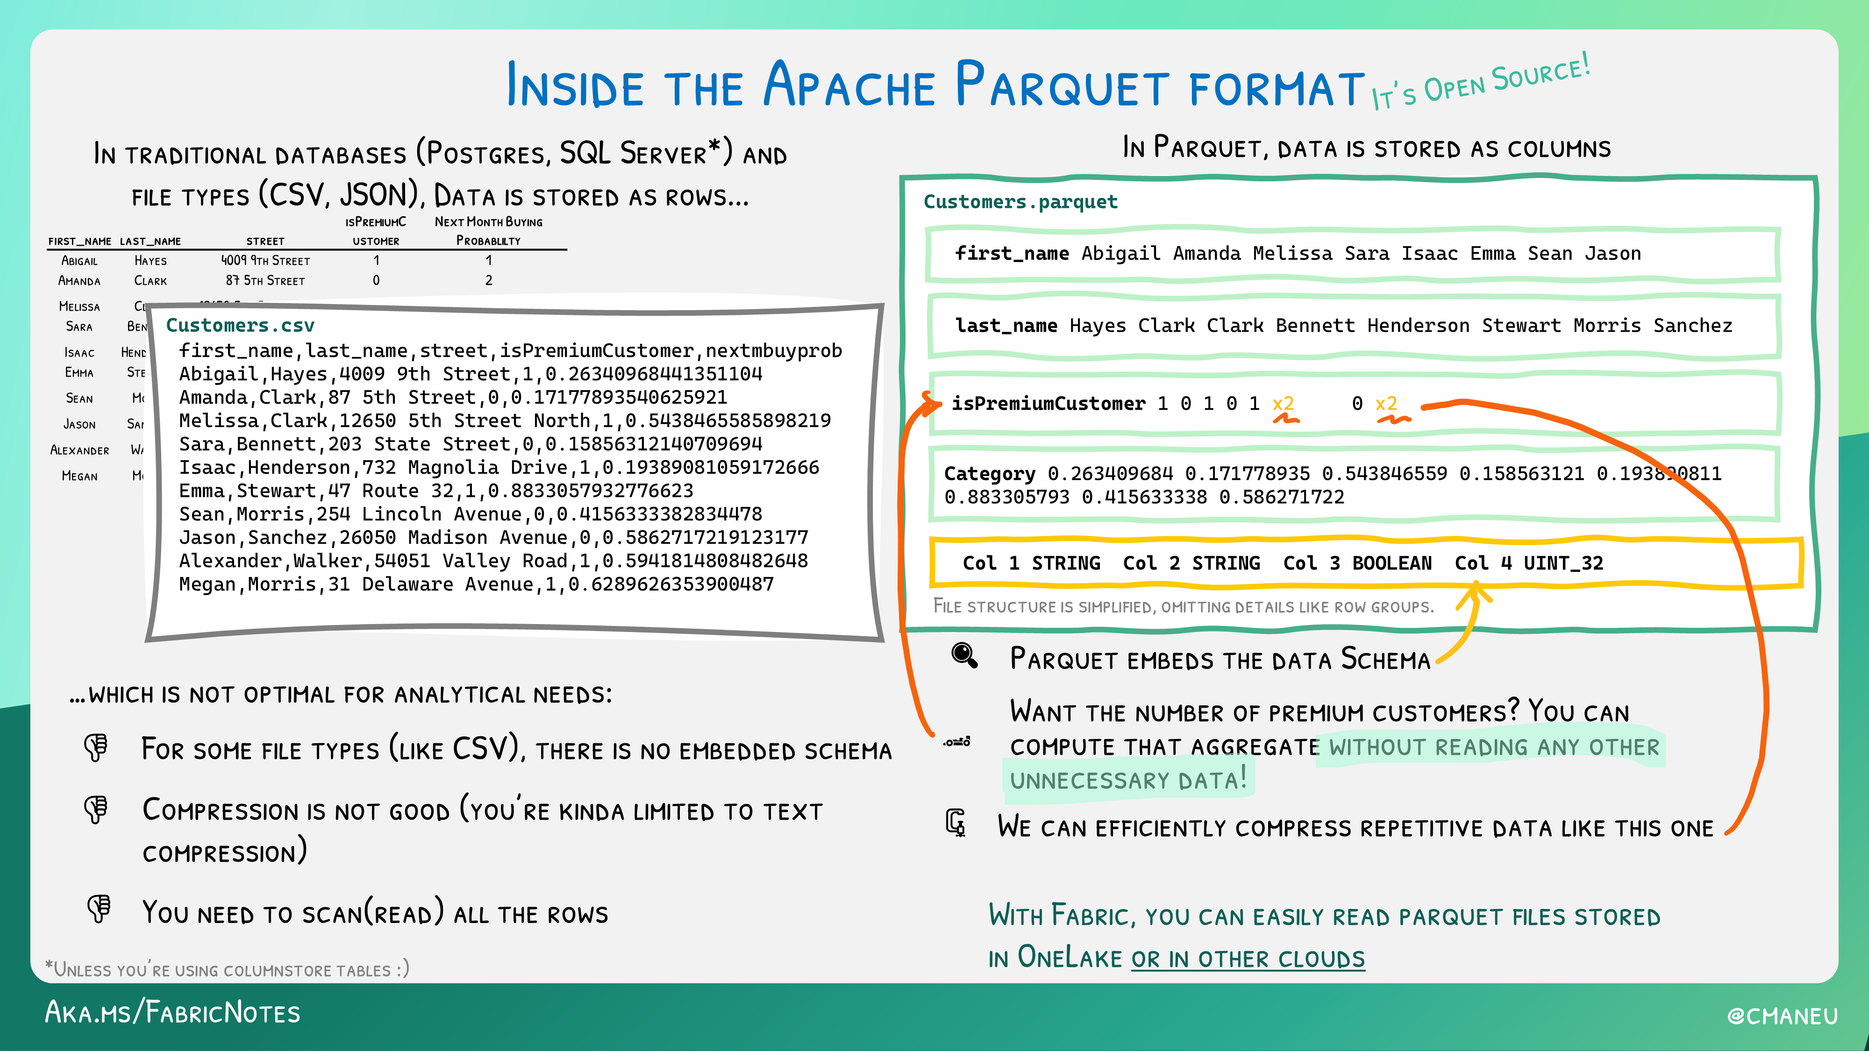

Slide 13
What is a Lakehouse?
“…An open architecture that combines the best elements of data lakes and data warehouses.”
Proposed by Databricks in whitepapers in 2020/2021
10 key features
Often organized in medallion architecture

Slide 14
Key features of a Lakehouse
Transaction (ACID) support
Schema enforcement and governance
Supports BI tools
Storage is de-coupled from Compute
Open standards

Slide 15
More key features
Supports both structured and unstructured data
Supports multiple types of analytics workloads
Real-time streaming data
Security and access control
Data governance and data catalogs

Slide 16
Delta Parquet
Delta layer provides compatibility for ACID transactions, as well as schema drift
All delta is parquet, not all parquet is delta

Slide 17
Medallion architecture
Bronze layer – raw data, staging
Silver layer – cleansed and conformed data, possibly third-normal form (3NF)
Gold layer – curated and transformed, possibly in a star schema
Learn more at: www.databricks.com/glossary/medallion-architecture

Slide 18
Lakehouse Demo
Learn more at: https://learn.microsoft.com/en-us/fabric/data-engineering/lakehouse-overview

Slide 19
Synapse Data Warehouse
More traditional data warehousing experience
Structured data, usually in a star schema relationship (ie. facts and dimension)
Develop primarily with T-SQL; Query with T-SQL code or visual editor
Data is still stored in the open-source Delta Parquet format!

Slide 20
Data Warehouse Demo
Learn more at: https://learn.microsoft.com/en-us/fabric/data-warehouse/data-warehousing

Slide 21
Lakehouse vs. Warehouse?
Structured and unstructured data vs. only structured data
Spark (PySpark, Scala, Spark SQL, etc.) vs. T-SQL
Highly complex data structures and transformations vs. denormalized tabular data
Data scientist and data engineer vs. SQL developer and data analyst
Learn more at: https://youtu.be/cmQ9hs8DdR0

Slide 22
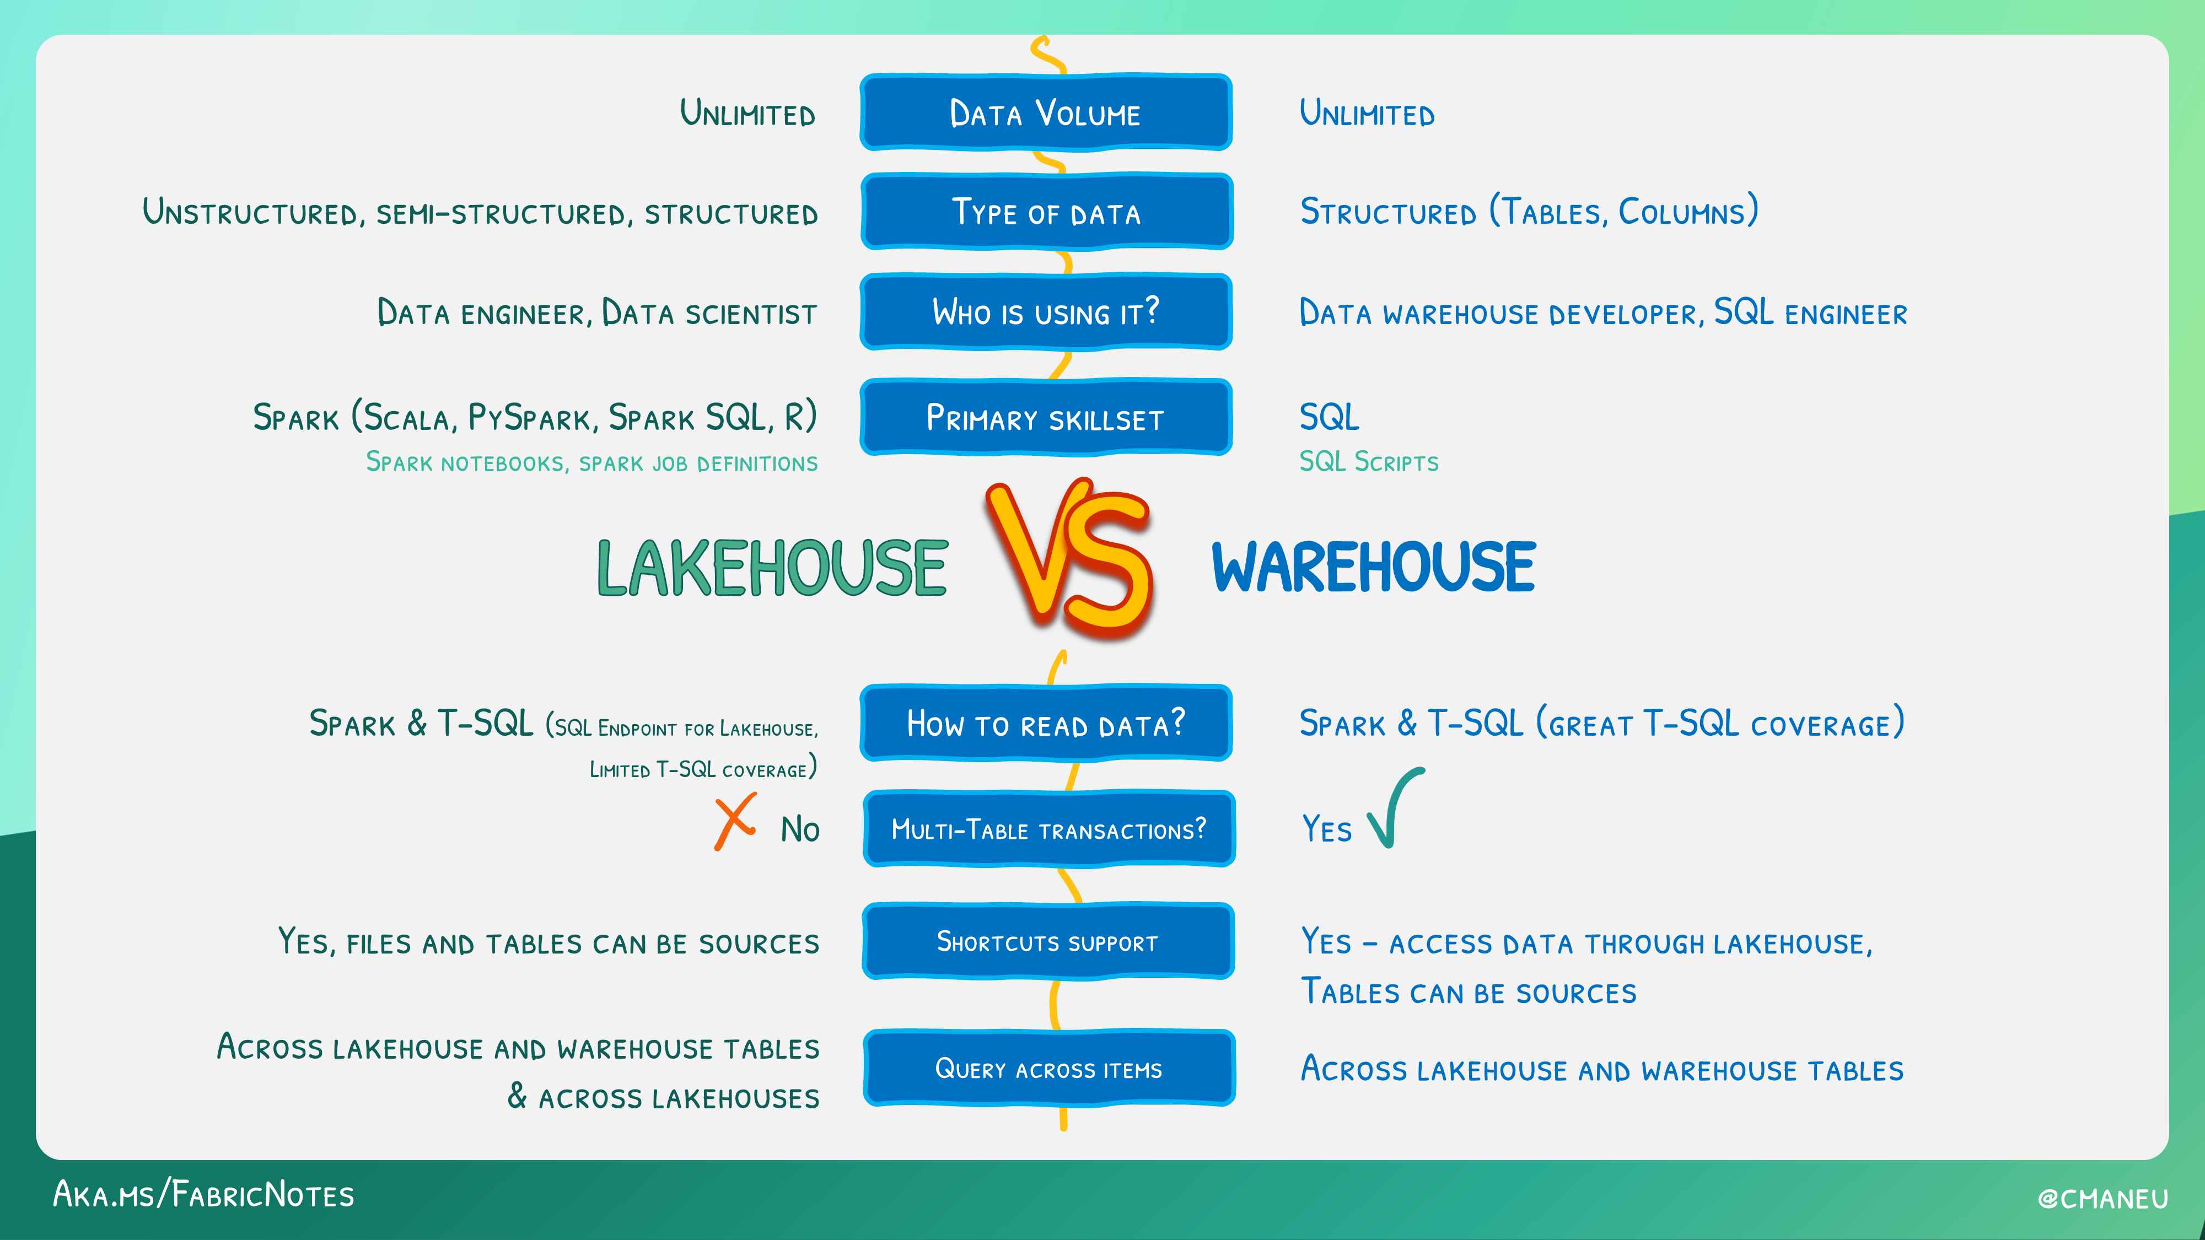
Demo

Slide 23
Synapse Data Science
Notebooks – train models
Experiments – evaluate models
Models – store in the workspace
Learn more at: https://learn.microsoft.com/en-us/fabric/data-science/data-science-overview

Slide 24
Real-Time Analytics
End-to-end streaming solution for high-speed data analysis
Optimized for time-series analysis
Kusto Query Language (KQL) only
Learn more at: https://learn.microsoft.com/en-us/fabric/real-time-analytics/overview

Slide 25
Power BI
Direct Lake mode (diagram next slide)
Many limitations currently in public preview
Limitations detailed at: https://learn.microsoft.com/en-us/power-bi/enterprise/directlake-overview#known-issues-and-limitations

Slide 26
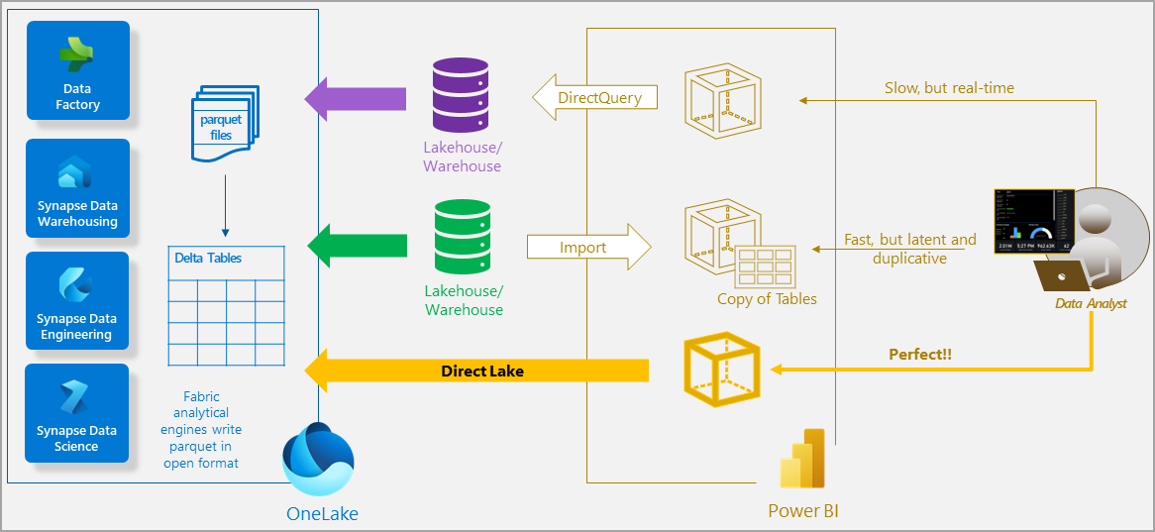
Demo

Slide 27
Power BI Demo
Learn more at: https://learn.microsoft.com/en-us/power-bi/fundamentals/power-bi-overview

Slide 28
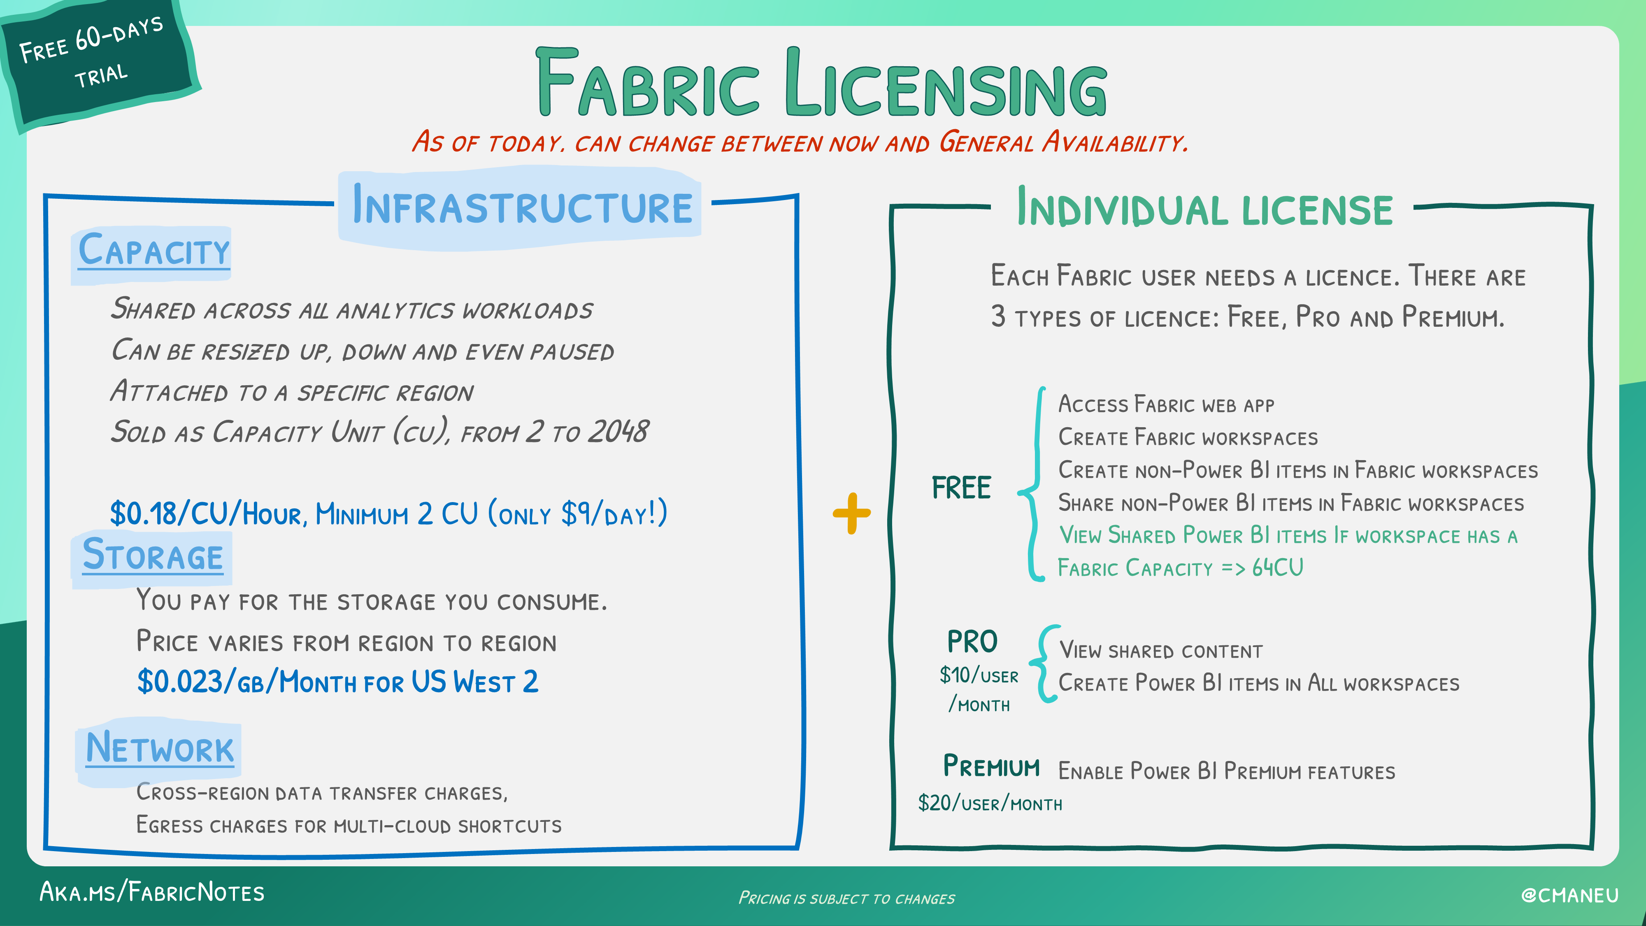

Slide 29
Resources
https://github.com/DrJekyll325/Presentations
azure.microsoft.com/en-us/blog/introducing-microsoft-fabric-data-analytics-for-the-era-of-ai/
learn.microsoft.com/en-us/fabric/get-started/microsoft-fabric-overview
aka.ms/fabric-learn

Slide 30
Video Resources
aka.ms/fabric-webinar-series/
www.youtube.com/watch?v=-f0XIVEP7bE&list=PLv2BtOtLblH1RhbtfTpp9ovi3Y-3HiRO2

